Slide 1
SOLOW MODEL OF GROWTH
Robert Merton Solow is an American economist particularly known for his work on the theory of economic growth that culminated in the exogenous growth model named after him.
Presented By
Premananda Boro

Slide 2
SOLOW MODEL OF GROWTH
According to prof. Solow, for attaining long run growth, let us assume that capital and labour both increase but capital increases at a faster rate than labour so that the capital labour ratio is high. As the capital labour ratio rises, the output per workers declines and as a result national income falls. The saving of the community decline and in turn investment and capital also decrease. The process of decline continues till the growth of capital becomes equal to the growth rate of labour. Consequently, capital labour ratio and capital output ratio remain constant and this ratio is popularly known as “Equilibrium Ratio”.

Slide 3
ASSUMPTIONS
There is full employment in the economy.
The two factors of production are capital and labour.
Labour and capital are substitute for each other.
There is flexible system of price-wage interest.
Available capital stock is fully utilized.
One composite commodity is produced.
Investment is not of depreciation and replacement charges.

Slide 4
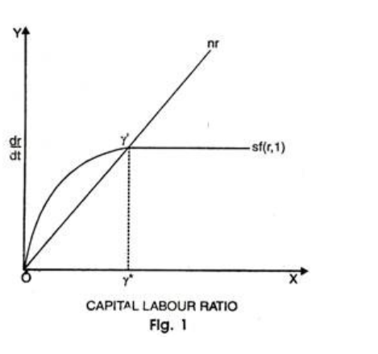
DIAGRAM

Slide 5
In the above Fig. 1 shows that on x-axis represent the capital for worker and y- axis indicate the output output per Worker (Y/N). the line I=S=f(K) passing. Through the origin shows the depreciation curve (d=dk). when increase in capital, depreciation also increases. In the above depreciation curve it is Shown the I = S = f(k) which is investment. we multiple by savings, then we get the save in spent in investment in above curve represent the production, output per worker increase at a diminishing rate as K increases due to law of diminishing returns with increase in K/N we get increase in Y/N output per workers.
In the above Explanation we get the conclusion. when Investment is greater than Depreciation the capital grows on the other hand, when Investment is less than Depreciation. the capital Shrinks (machinery, wear and tear) is more than the Investment. At the point equilibrium. occurred "Steady state" (ss) equal to the Depreciation.

Slide 6
CRITICISM
Unrealistic Assumption of Homogenous & Malleable Capacity:
Solow model is based on the unrealistic assumption that exists homogeneity and malleable of capital. In fact, capital goods are very much heterogenous and so there arises the problem of their aggregation.
2. Absence of Empirical Justification:
Solow model is based on the assumption of labour increase technical progress. But there is no empirical justification of this assumption. It is simply a special situation of neutral technical progress of Harrod-Domar model.

Slide 7
Disclaimer:
This study material is prepared from available text books and various open access online resources. The purpose of this material is purely to benefit the students.

Slide 8
THANK YOU

